Slide 1


AfriTech Electronics Ltd. – Brand Reputation & Crisis Management Analysis
Strategic Insights and Business Recommendations
Presented by:
Adefemi Adegbite

Slide 2





Business Problem
Negative Social Media
Rising sentiment issues online
Customer Complaints
High volume of dissatisfaction
Product Recalls
Frequent quality issues
Market Impact
Declining trust and sales

Slide 3
Customer & Transaction Trends
200
74K
Total Customers
Total Transactions
Active customer base
16% decline from 2022-2023
2022: 38,000, 2023:32000
$81.1K
Avg Daily Spend
9.5% decrease year-over-year 2022: $84.5k
2023: $76.5k

Slide 4
Recall Impact and Spending Behavior
2022 Recalls
2023 Recalls
157 customers initiated returns
158 customers despite fewer transactions
Persistent high recall rate indicates ongoing quality issues

Slide 5
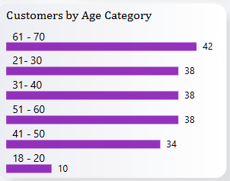
Customer Age Distribution & Trends
21-30, 31 – 40, 51-60 Years
41-50 Years
Strong working-age representation : 38 each (19% )
Underrepresented youth segment: 34( 17%)
61-70 Years
18-20 Years
Largest segment: 42 (21%)
Underrepresented youth segment: 10(5%)

Slide 6










Customer Income Distribution
High Income
3.5% (7 customers)
Upper Middle
20% (40 customers)
Middle Income
47.5% (95 customers)
Lower Middle
24% (48 customers)
Low Income
5% (10 customers)

Slide 7

Transaction Across Age Groups
Top Purchasing Groups
51-60 years old: 16K transactions (Highest volume, likely professionals)
61-70 years old: 15K transactions (Strong engagement from retirees/older adults)
Middle-Aged & Young Adults
21-30 years old: 13K transactions (Digital-native buyers)
41-50 years old: 13K transactions (Family-focused purchasers)
31-40 years old: 12K transactions (Established career-stage buyers)
18-20 years old: 4K transactions

Slide 8
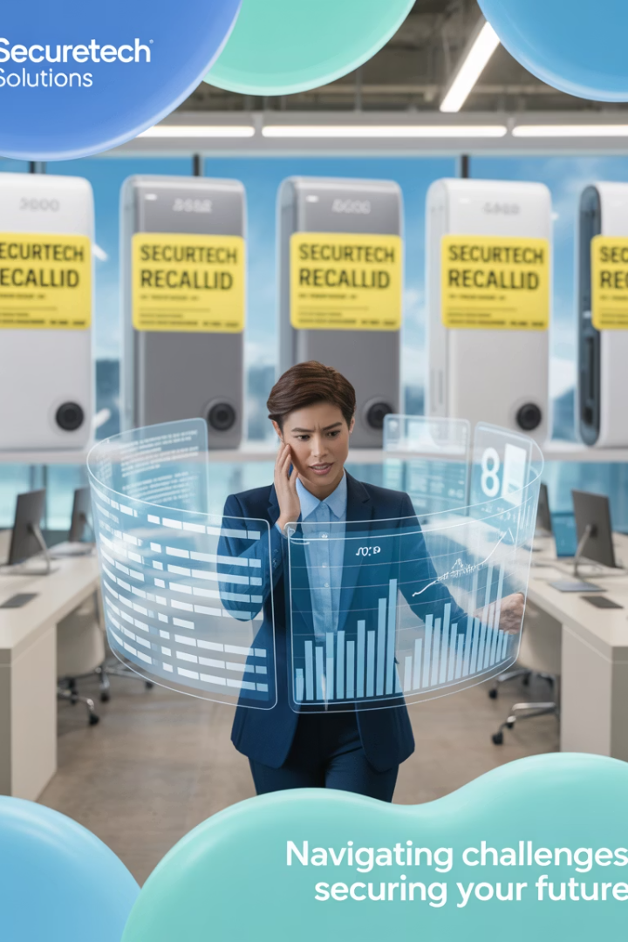
Revenue and Recall Impact
Total Revenue
Revenue Decline
$58M over evaluated period
20% drop from $30M (2022) to $24M (2023)
Recall Impact
50.2% loss in potential revenue

Slide 9



Revenue Lost to Recalls
Total Revenue Lost
$28.9M due to recalls
2022 Losses
$15.4M from recalls
2023 Losses
$11.8M from recalls
Nearly half of potential earnings lost to product reliability issues

Slide 10




Revenue by Age and Income Groups
Older Demographics (51-60) $12.8m, (61-70) $11.3m
Largest revenue share, brand resonates with mature audience
Adults (21-30) $10.5m, (41-50) $10.3m, (30-40) $9.9m
Strong representation, opportunity for digital marketing
Youth Segment (18-20) $2.8m
Significantly smaller, potential growth area

Slide 11
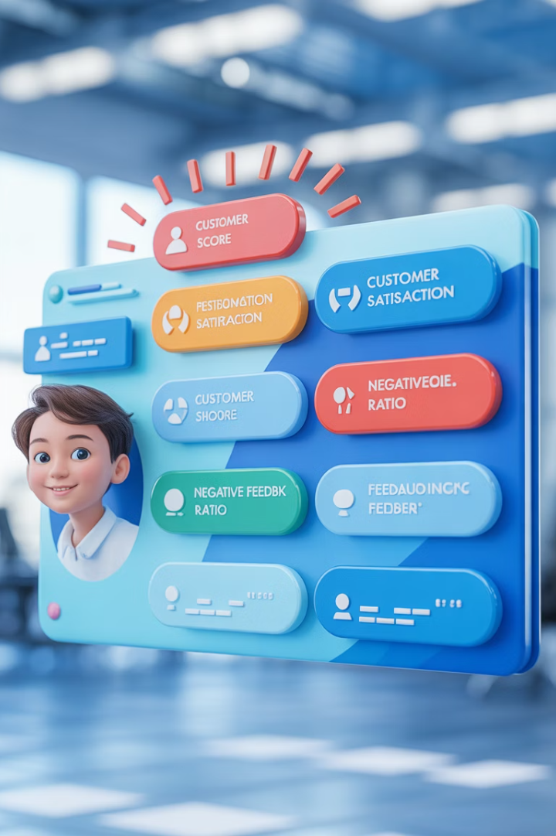
Sentiment & Crisis Overview
292M
Total Engagement
38K
37K
AfriTech Mentions
Competitor Mentions
4.96
NPS Score
8.66%
Crisis Resolution
Critically low

Slide 12






Customer Sentiment Breakdown
Passives
17% - neutral and disengaged
Promoters
18% - low loyalty and advocacy
Detractors
64% - serious reputation issue

Slide 13

Product & Crisis Impact
Total Recalls
37,000 products returned
Customer-Initiated
184/200 customers
Reported Crisis
13,000 public complaints
Resolution Rate
Only 8.66% issues resolved

Slide 14




Crisis Response Time
Issue Reported
Customer complaint via TikTok, Instagram, Facebook,
LinkedIn and Twitter
Waiting Period
190 days average response
Maximum Delay
715 days (2+ years)

Slide 15

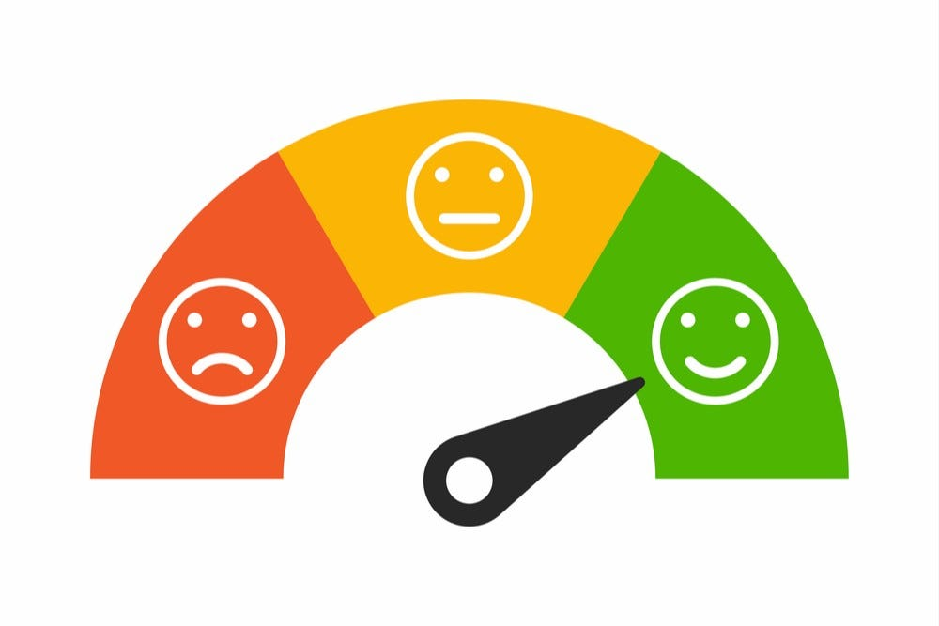
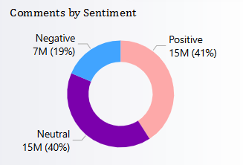
Comments by Sentiment
Positive Sentiment Leads (41%)
Good news: A significant portion of customers are satisfied.
High Neutral Sentiment (40%)
Indifference could signal missed opportunities to delight users.
Negative Sentiment Concerning (19%)
Nearly 1 in 5 comments are critical—likely tied to product recalls/slow crisis response.

Slide 16
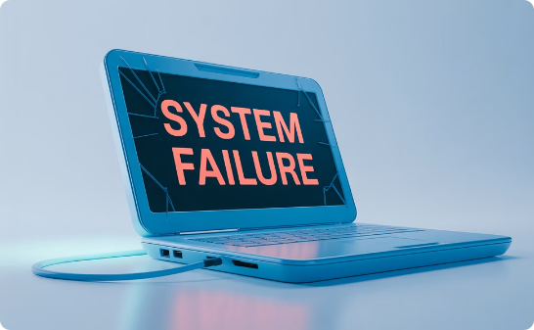
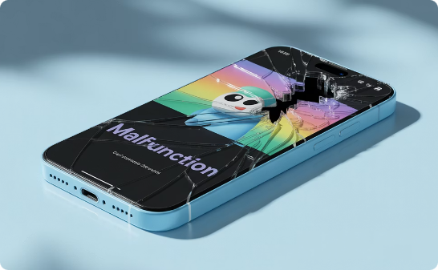
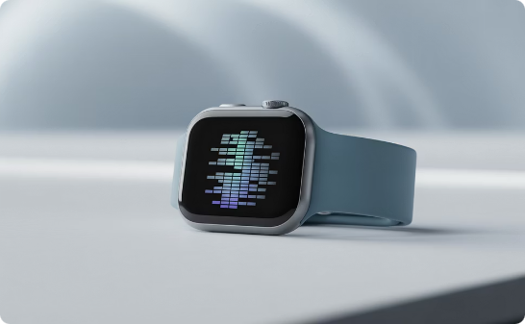
Recalls by Product Category
Laptops
Smartphones and Tablets
Smartwatches
Highest recalls and resolution focus
9611 recalls
High recalls, many unresolved
9443 and 9437 recalls
A bit high recalls, better reliability
8968 recalls

Slide 17
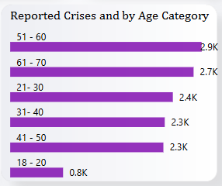

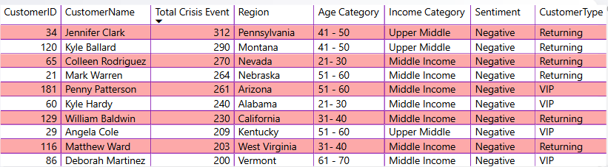
Reported Crisis by Age and Top 10 dissatisfied customers

Slide 18





Strategic Recommendations
Improve Product Quality
Enhanced testing protocols
Launch Support Program
Immediate Crisis Response (24 to 48hours)
Target Younger Audiences
Expand marketing reach
Simplify for Seniors
Video guides, senior-friendly UI

Slide 19

Strategic Recommendations
Trade-in program targeting rival brands
Side-by-side quality comparisons
Quality Emergency
Extended warranties for recent buyers
Second Chance" program for negative reviewers
Free diagnostic checks

